Slide 1
JavaScript
ICT-Training Technical Skills

Slide 2
Introduction
JavaScript is the world's most popular programming language.
JavaScript is the programming language of the Web.
JavaScript is easy to learn.
JavaScript is a cross-platform, object-oriented scripting language used to make webpages interactive (e.g., having complex animations, clickable buttons, popup menus, etc.).
There are also more advanced server side versions of JavaScript such as Node.

Slide 3
First public release of JavaScript
The first public release of JavaScript was integrated in Netscape Navigator 2.0, released in 1995.
JavaScript was initially created as a browser-only language, but it is now used in many other environments as well.

Slide 4
Document Write of JS
<script type=“text/javascript”>
document.write(“<h1>Welcome to JavaScript</h1>”);
</Script>

Slide 5
Displaying alert box
<script type=“text/javascript”>
Window.alert(“welcome”);
</Script>

Slide 6
Rules of JavaScript
JavaScript is case-sensitive.
Statements should end in a semicolon (;)
. Variables: Must be defined before being used.
The variable name can contain A – Z, a – z, underscore or digits and must start with a letter or an underscore (“_”).

Slide 7
JavaScript Keywords
Keywords are reserved words in JavaScript that cannot use to indicate variable labels or function names.
There are a total of 63 keywords that JavaScript provides.

Slide 8
Datatype use of JavaScript
JavaScript variables can hold different data types: numbers, strings, objects and more.
<script type=“text/javascript”>
var name=“Welcome”;
document.write(“name”);
</Script>

Slide 9
Two number of Addition
<script type=“text/javascript”>
var number1=10;
var number2=20;
var sum=number1+number2;
document.write(sum);
</script>

Slide 10
If statement
Syntax
if (condition)
{
Statement
}

Slide 11
If Statement Example
<html>
<head>
<script type=“text/javascript”>
var mark=1;
if(mark>= 50)
{
document. write(“pass”);
}

Slide 12
Continue…
else
{
document. write(“fail”);
}
</script>
<body>
</body>
</html>

Slide 13
For Loop
Syntax
for(initialization; condition; increment)
{
statement
}

Slide 14
While Loop
Syntax
while(condition);
{
Statement;
}

Slide 15
Do While Loop
Syntax
do
{
Statement;
}
while(condition);

Slide 16
Getting input from the user
<html>
<head>
<script type= “text/javascript”>
var name=window. prompt (“Enter the name”);
document. write(name);
</script>
<body>
</body>
</html>

Slide 17
Switch case statement
Syntax
switch(expression) {
case condition 1:
statement(s) Break;
case condition 2:
statement(s) Break;
…. case condition n:
statement(s) Break;
default:
statement(s); }

Slide 18
Array
We can store multiple value
In computer science, array is a data type that represents a collection of elements (values or variables), each selected by one or more indices (identifying keys) that can be computed at run time during program execution.
Such a collection is usually called an array variable or array value.

Slide 19
Array
Example:
var marks=new Array(“Apple”, “Orange”, “Mango”);
fruits(0)-first element
fruits(1)-first element
fruits(2)-first element

Slide 20
DOM (Document Object Model)
Dom is the whole html document.
It is root element that represents the html document.
HTML DOM model is constructed as a tree object.
Value – get – Domain – Front End
Accessing the field value by document object. Link here

Slide 21
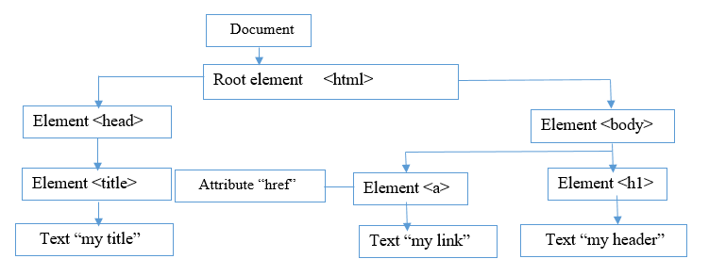
DOM (Document Object Model)

Slide 22
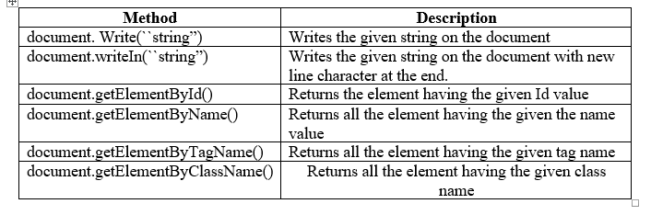
Methods of document object

Slide 23
Object
Object in javascript is represent as a name value, pair.
Create object is “var”
Var name=new object();

Slide 24
Built. in Objects
Built. in objects (free define function)
In JavaScript, almost "everything" is an object.
Booleans can be objects (if defined with the new keyword)
Numbers can be objects (if defined with the new keyword)
Strings can be objects (if defined with the new keyword)
Dates are always objects.

Slide 25
Built. in Objects
Maths are always objects
Regular expressions are always objects
Arrays are always objects
Functions are always objects
Objects are always objects
All JavaScript values, except primitives, are objects.

Slide 26

Math Objects
The math object provides you properties and methods for mathematical contracts and functions.
Syntax:

Slide 27
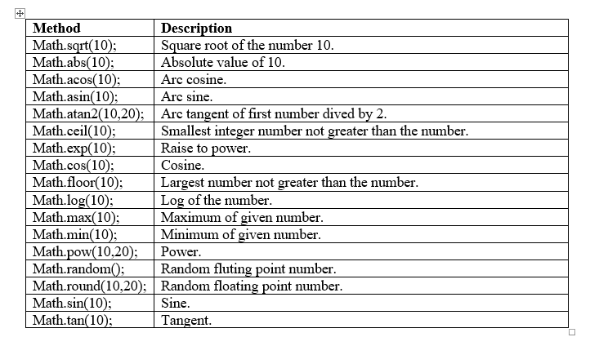
Math Objects

Slide 28

String
The string object lets you work with a series of characters.
It wraps Javascripts string primitive data type with a number of helper methods.
Syntax

Slide 29
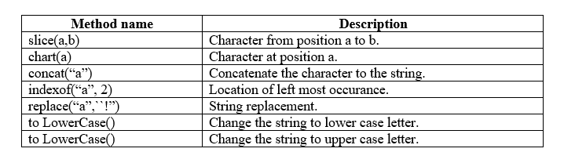

Slide 30
Regular Expression
It is a certain way of represting the set of strings.
It is used to test the string present in the HTML form.
Example, the set of strings that consists of exactly three digits. -\d\d\d.
RegExp( ) begins with a caret(^) and ends with a dollar sign($).

Slide 31

Regular Expression
Syntax

Slide 32
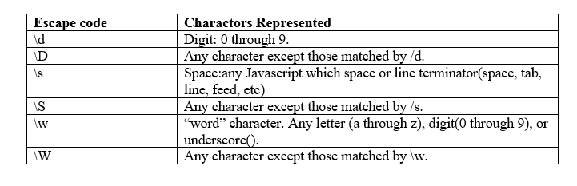
Javascript Multicharacter Escape codes

Slide 33
Word combination & Digit Combination
Qualifier shorthand notation
Union
Represented by the pipe symbol.
(e.g) \d|\s – represents the set of consisting of all digit and white space characters.
Kleene Star
Allows us to represented infinitely larger sets.
(e.g)\d* - represents the set of strings of any number of digits.

Slide 34

Word combination & Digit Combination
The concatenation of two regular expressions represents the set of strings represents the set of strings that consists of any string represented by the first reqular expression.
Concatenated with any string represented by the second expression.
Eg.

